Slide 1
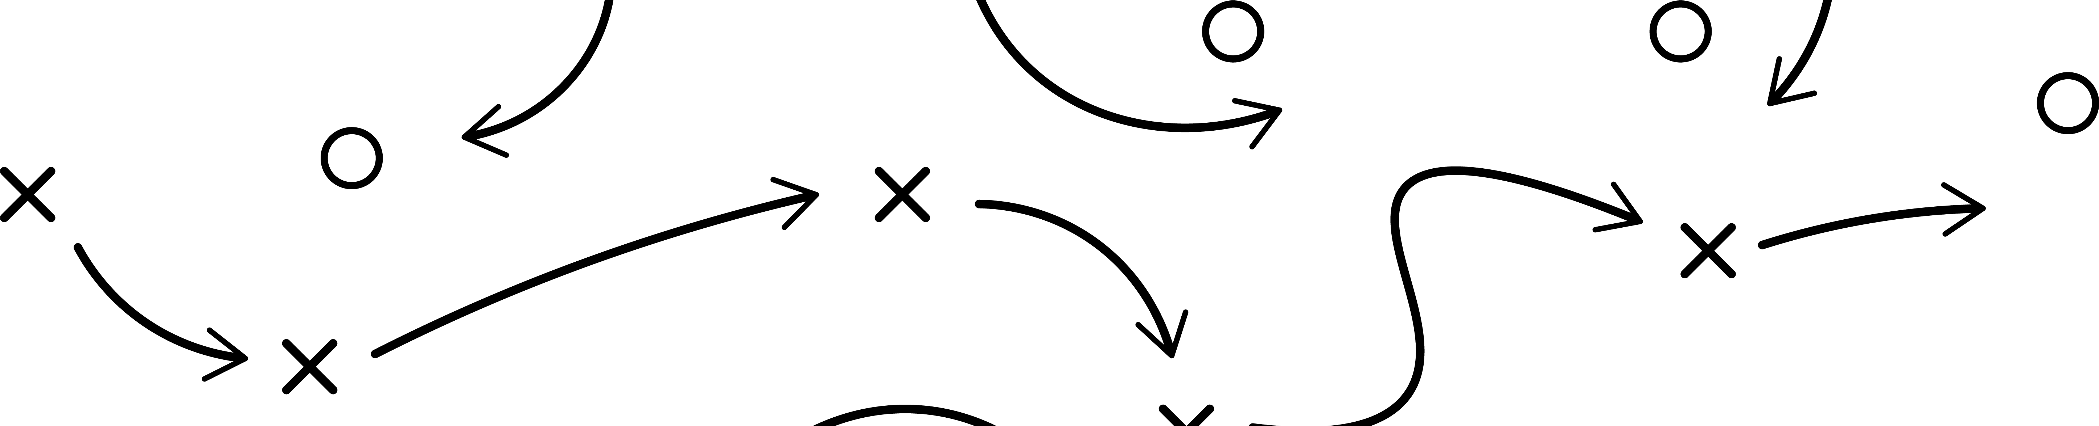














PREMION | SPORTS CONTENT PACKAGES
Choose the Live, In-Game Sports
Packages that Work for Your Brand
OVER 20 SPORTS PACKAGES BUILT FOR EVERY FAN - 100% CTV
MLB
Regular Season |
Playoffs + World Series
NFL
Regular Season |
Playoffs
NBA
Regular Season |
Playoffs + NBA Finals
NHL
Regular Season |
Playoffs + Stanley Cup
NCAA Football
Regular Season | Conferences | Playoffs + National Championship
NCAA Basketball
Regular Season |
March Madness
Soccer
Run-of-Network |
FIFA World Cup
WNBA
Regular Season |
Playoffs
Golf
Run-of-Network |
PGA Majors
Motorsports
NASCAR Cup + Xfinity Series +
Truck Series + IndyCar + Indy 500
All Live Sports
Run-of-Network in‑game,
live sports inventory
Prestige Sports
Tennis + Sail Grand Prix +
Golf + Horse Racing
Keep score on every campaign with weekly reporting on geo, impressions, and VCR, along
with post-campaign insights that include detailed channel- and game-level performance.

